Slide 1
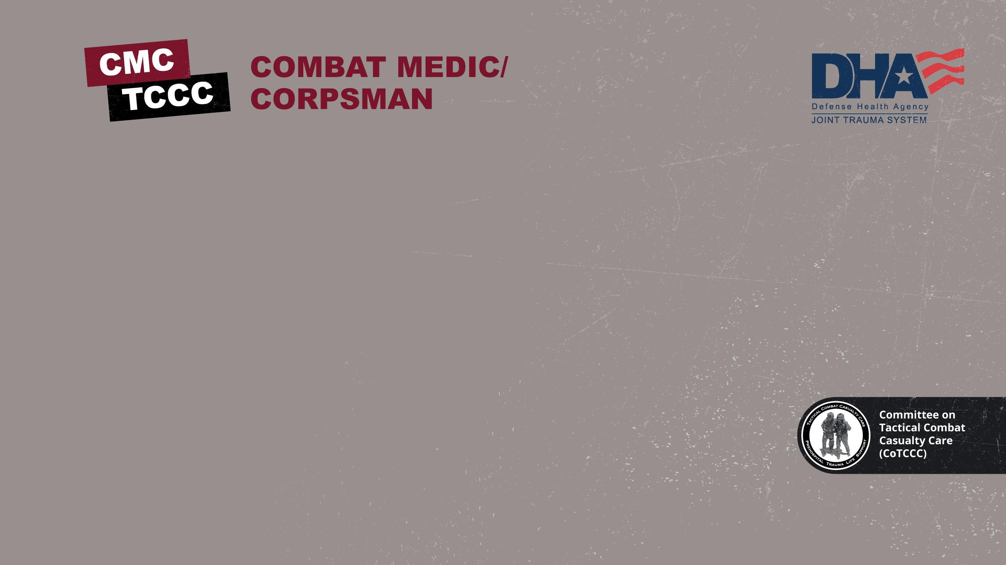

TACTICAL COMBAT CASUALTY CARE COURSE
MODULE 17: WOUND MANAGEMENT
Module 17: Wound Management
TCCC TIER 1
All Service Members
TCCC TIER 2
Combat Lifesaver
TCCC TIER 3
Combat Medic/Corpsman
TCCC TIER 4
Combat Paramedic/Provider

Slide 2
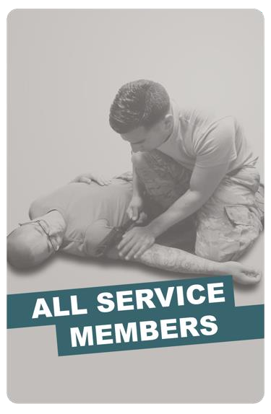
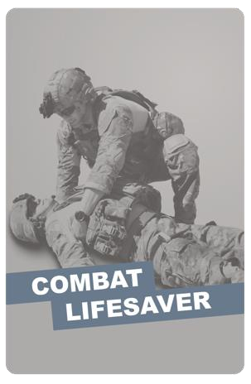
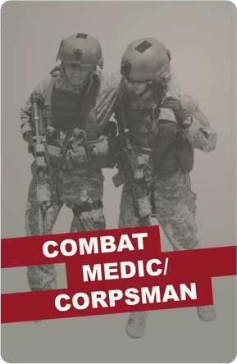
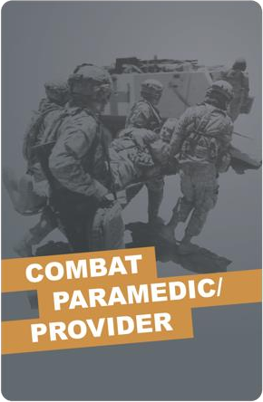
Module 17: Wound Management
TACTICAL COMBAT CASUALTY CARE (TCCC) ROLE-BASED TRAINING SPECTRUM
ROLE 1 CARE
NONMEDICAL PERSONNEL
MEDICAL PERSONNEL
YOU ARE HERE
STANDARDIZED JOINT CURRICULUM
2

Slide 3






Module 17: Wound Management
1 x TERMINAL LEARNING OBJECTIVES
20 Given a combat or noncombat scenario, perform assessment and initial management of wounds during Tactical Field Care in accordance with CoTCCC Guidelines.
20.1
20.2
Identify wound management considerations in Tactical Field Care.
Demonstrate application of open abdominal, impalement, and amputation
wound dressings in Tactical Field Care.
02 x ENABLING LEARNING OBJECTIVES
#
= Terminal Learning Objectives
= Cognitive ELOs
= Performance ELOs
3

Slide 4


MARCH PAWS
Module 17: Wound Management
LIFE-THREATENING
M MASSIVE BLEEDING
#1 Priority
A AIRWAY
R RESPIRATION (Breathing)
C CIRCULATION
_{H} HYPOTHERMIA / HEAD INJURIES
AFTER LIFE-THREATENING
P A
PAIN
ANTIBIOTICS
W
WOUNDS
S
SPLINTING
4

Slide 5
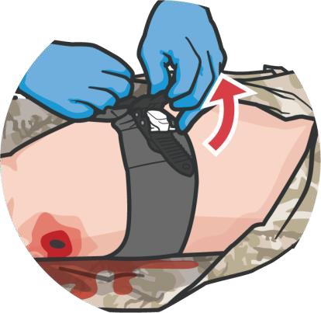
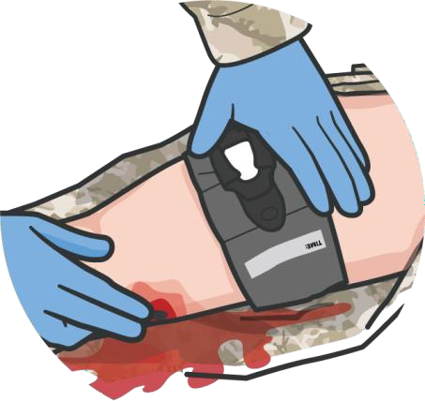
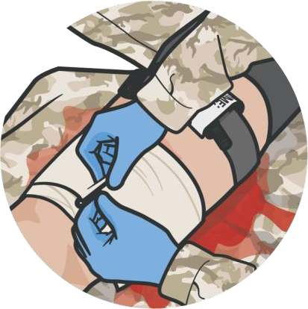

GENERAL WOUND MANAGEMENT PRINCIPLES
Module 17: Wound Management
REASSESS prior life- threatening wounds to ensure bleeding is still controlled
If bleeding has not been controlled:
Tighten or add second tourniquet
Add packing or tighten
pressure bandages
Redress the wounds
Shield any exposed eye injuries
Address any unsealed open
chest wounds
Only after reassessing all previously addressed wounds should you address non-life- threatening, or minor wounds
REMEMBER: NEVER apply a tourniquet and forget it!
P A
W
S
5

Slide 6
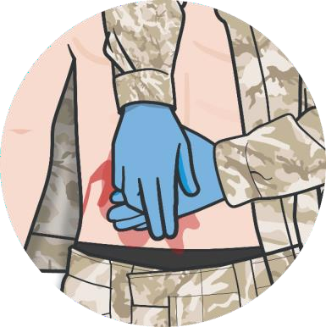
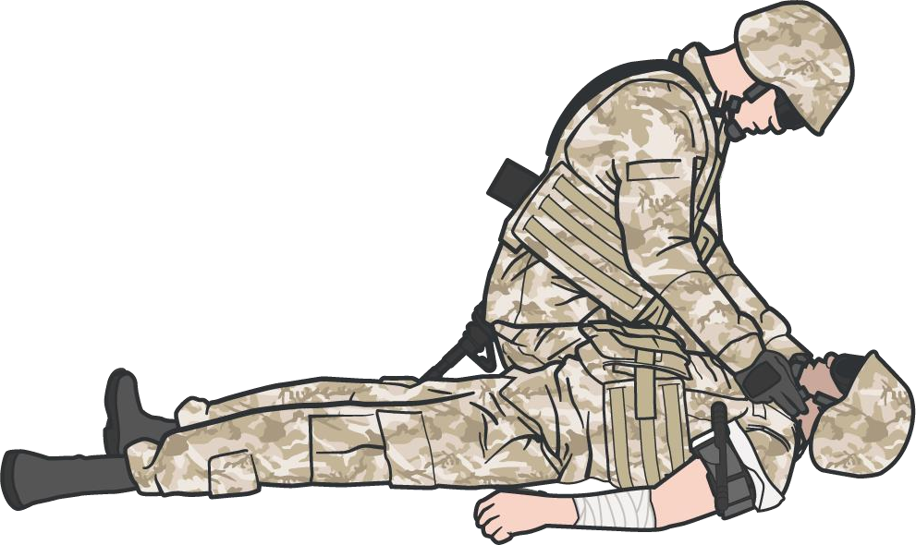
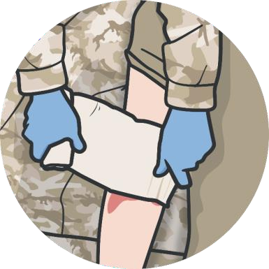
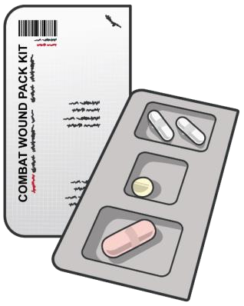
Module 17: Wound Management
GENERAL WOUND MANAGEMENT PRINCIPLES (CONT.)
Non-life-threatening wounds could
include:
Apply direct pressure, as needed (hemostatic dressings not indicated minor bleeding)
Irrigate & clean wounds
with sterile or clean water
Dress wounds with gauze and bandages or dry, clean cloth
Administer antibiotics
Lacerations without
massive bleeding
Abrasions
Open abdominal wounds Impaled objects Amputation stumps
Hemostatic dressings not indicated for minor bleeding
P A
W
S
6

Slide 7
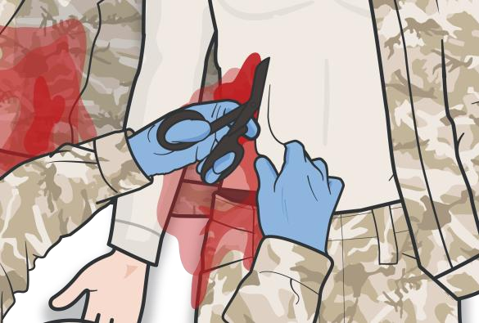
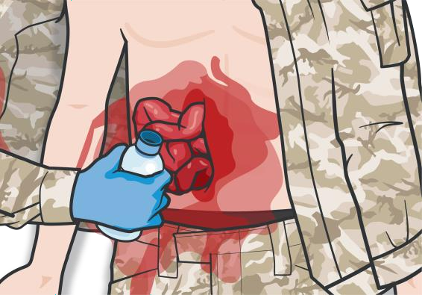
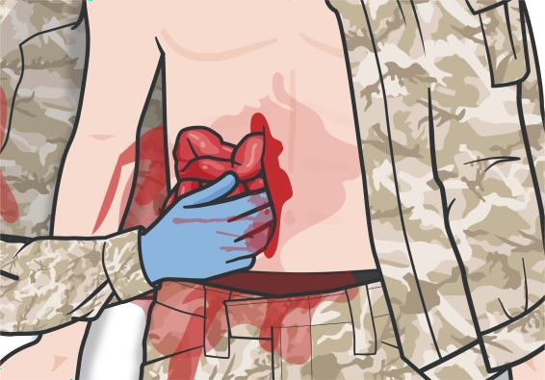
OPEN ABDOMINAL WOUND MANAGEMENT
Module 17: Wound Management
CAUTION:
DO NOT attempt if there is evidence of ruptured bowel (gastric/intestinal fluid or stool leakage) or active bleeding.
DO NOT FORCE
contents into abdomen or actively bleeding viscera or remove foreign objects.
MANAGEMENT STEPS:
1
PLACE the casualty in the supine position, with knees flexed
Expose the wound inspecting for DCAP- BLS and TRD-P
3a
Rinse the wound with clean (and warm, if possible) fluid
Apply CoTCCC-
recommended hemostatic
4
Consider a single brief attempt (<60 sec.) to reduce/replace eviscerated
abdominal contents.
2
3b
dressing or hemostatic agent
to any uncontrolled bleeding.
P A
W
S
7

Slide 8
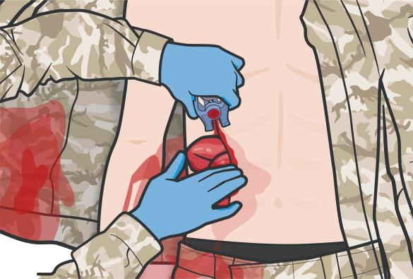
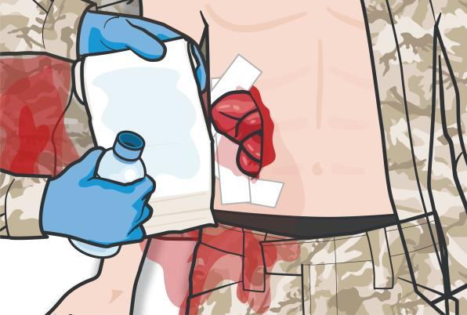
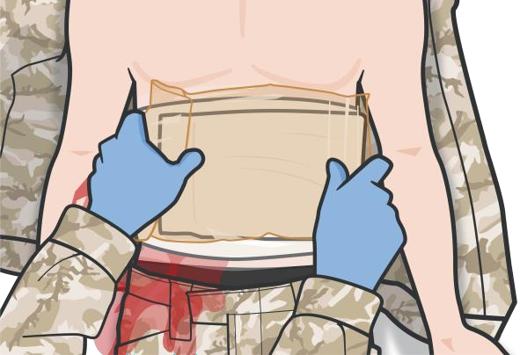
OPEN ABDOMINAL WOUND MANAGEMENT
Module 17: Wound Management
CAUTION:
Protruding abdominal organs
should be kept moist
Cover the entire mass of protruding organs or area of the wound.
Using the sterile side of the dressing, or other clean, damp material, gather or keep any protruding organs near the wound and cover the wound.
NOTE: Do not touch exposed
organs with bare hands.
If using a dressing with tails, tie loosely and do not tie directly over the wound.
MANAGEMENT STEPS:
5
If reduction attempt is successful, re- approximate the skin
Stabilize any
protruding objects
7
Cover exposed bowel with moist, sterile abdominal dressings
Cover the dressed, eviscerated organs with water impermeable non- adhesive material
9
Secure the impermeable dressing to patient using adhesive bandage
6
8
P A
W
S
8

Slide 9
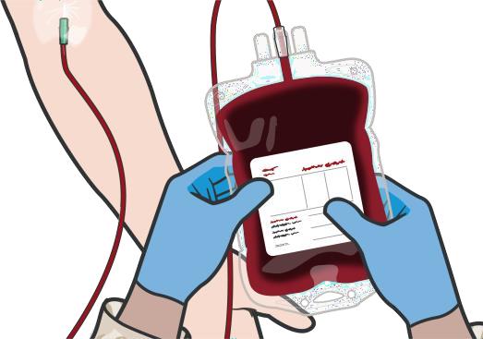
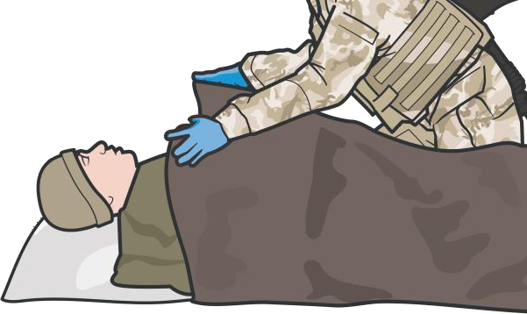
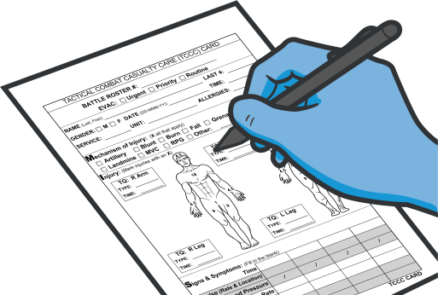
OPEN ABDOMINAL WOUND MANAGEMENT
Module 17: Wound Management
CAUTION:
The most important concern in the initial management of abdominal injuries is shock.
Shock may be
present initially or may
develop later.
MANAGEMENT STEPS:
10
Assess and treat the casualty for shock and continue to reassess periodically
11
Prevent hypothermia as exposed abdominal contents will result in more rapid heat loss
12
Document all findings and treatments on a DD Form 1380 TCCC
Casualty Card and
attach it to the casualty.
P A
W
S
9

Slide 10

MANAGING AN OPEN ABDOMINAL WOUND

Slide 11
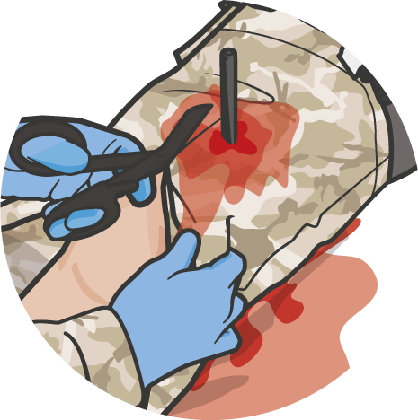
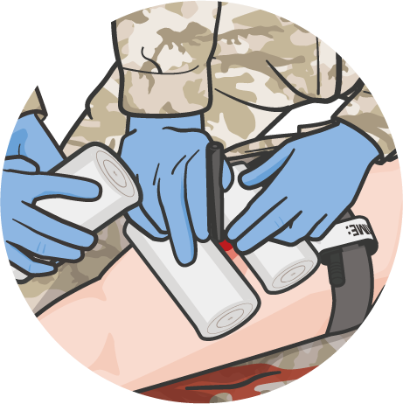
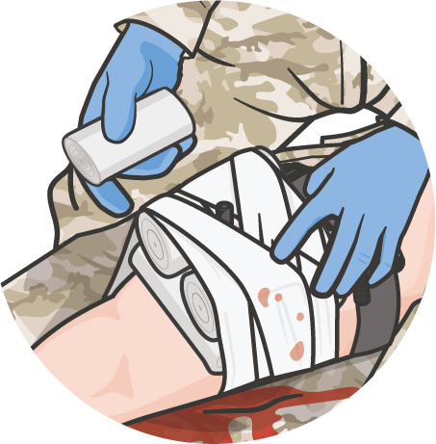
WOUND MANAGEMENT WITH IMPALED OBJECTS
Module 17: Wound Management
DO NOT remove impaled objects
CONSIDERATIONS:
Impaled object may be stopping internal bleeding
Internal structures may be damaged
by removal of impaled object
MANAGEMENT STEPS:
Expose the object
Control bleeding
Stabilize the object
Build up materials
around object
Use EXTREME CAUTION to
prevent movement of the impaled
object during casualty movement
Secure materials
& object
Splint, if indicated
P A W S

Slide 12
MANAGING AN IMPALED OBJECT

Slide 13
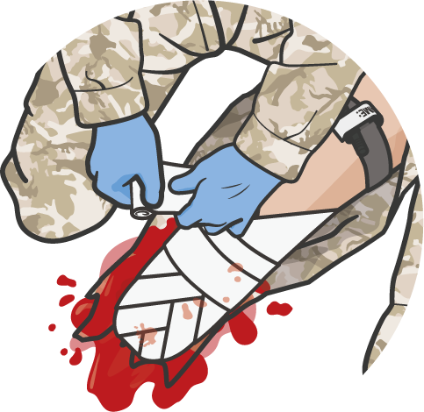
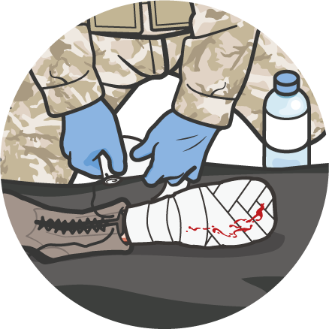
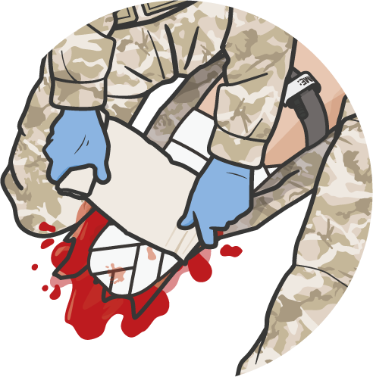
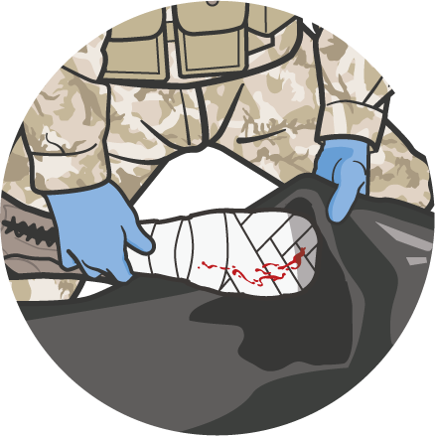
WOUND MANAGEMENT OF AMPUTATIONS
Module 17: Wound Management
Management of AMPUTATION WOUND STUMPS
Confirm bleeding controlled
(tourniquet, not direct pressure)
Wrap open areas with sterile
gauze or clean, dry cloth
Secure dressing with bandages or cravats, extending 4 in above the amputation
EXERCISE CAUTION: protruding sharp bones may injure responders Do NOT cover any tourniquets
Care of the AMPUTATED BODY PART
Wrap loosely with moistened
gauze
Place in plastic bag
Transport in container with ice,
preferably with casualty
Do NOT place body part directly on
ice or submerse in water
Do NOT delay evacuation to locate
or care for amputated body part
P A W S

Slide 14
AMPUTATION BANDAGING

Slide 15

SKILL STATION
Module 17: Wound Management
Wound Management
Open Abdominal Wound Dressings Impaled Object Wound Management Amputation Wound Management

Slide 16
SUMMARY
Module 17: Wound Management
General wound management principles
Open abdominal wound dressings Impaled object wound management
Amputation stump and amputated body part care
P A W S

Slide 17

CHECK ON LEARNING
Module 17: Wound Management
After applying pressure to stop bleeding, if necessary, what is the next step in treating a minor wound?
Name three of the four complications of open abdominal wounds
If an impaled object is on an extremity, what do you need to do in addition to stabilizing the object?
How do you care for an amputated body part?

Slide 18




Module 17: Wound Management
ANY QUESTIONS?

Slide 19
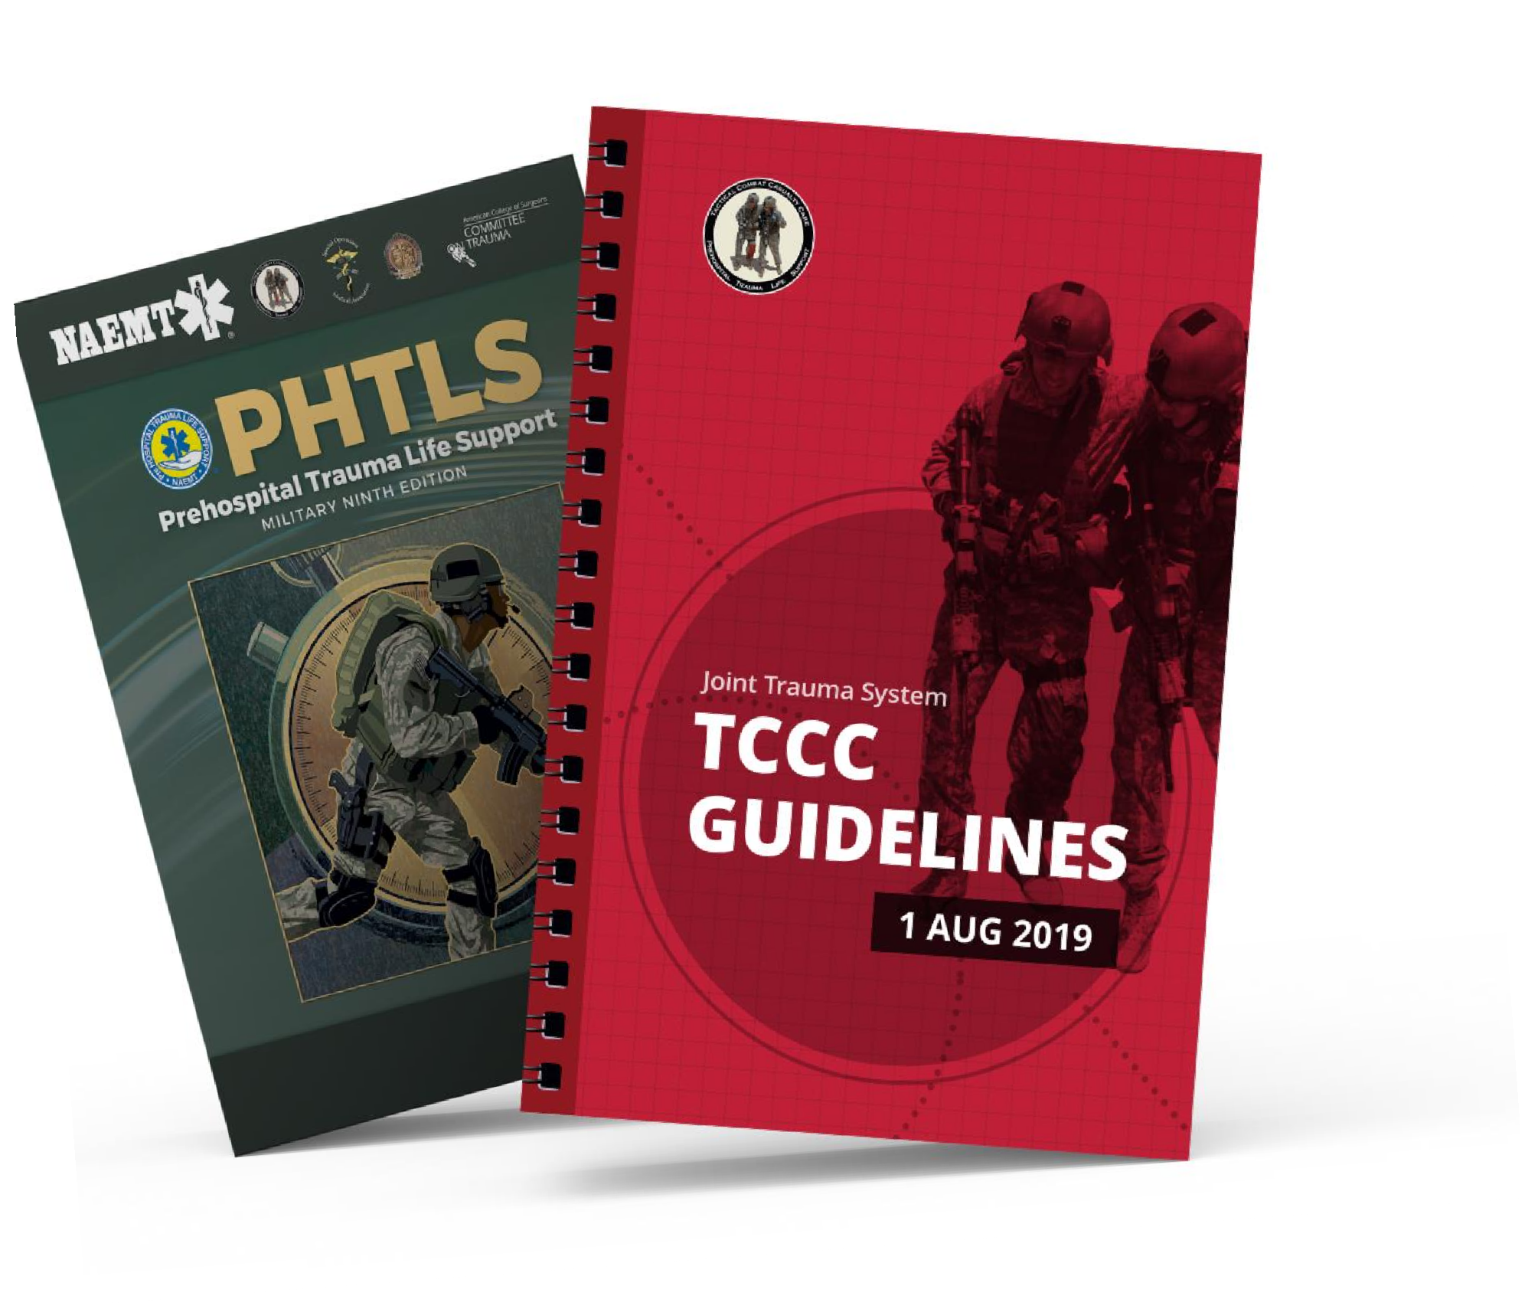
REFERENCES
Module 17: Wound Management
TCCC: Guidelines
by JTS/CoTCCC
Updated regularly – latest edition dated
5 November 2020
These guidelines are the result of decisions made by the Committee on Tactical Combat Casualty Care as they explore evidence-based research regarding best practices
PHTLS: Military Edition, Chapter 25
by NAEMT
Prehospital Trauma Life Support,
Military Ninth Edition

